Slide 1
The SEC’s Regulation Best Interest
What You Need to Know
Presented by NAIFA’s GR Team

Slide 2


NAIFA’s
GR Staff
Judi Carsrud and Gary Sanders

Slide 3


NAIFA’s Counsel
Steptoe & Johnson
Scott Sinder and Kate Jensen

Slide 4
Today’s Agenda
The Background
The Rule
The Client Relationship Summary (Form CRS)
Effective Date
State Activities
What This All Means in the Real World…

Slide 5

What a difference an agency makes!
Department of Labor’s “fiduciary” rule was unworkable and revealed the DOL’s lack of understanding of the market
SEC’s Reg BI is thoughtful and does what it set out to do – enhance the suitability standard, provide consumer protections, and maintain the choices consumers have when receiving investment services

Slide 6
Proposal, 2010
Proposal withdrawn, 2011
Re-Proposal, 2015
Court vacates in its entirety, March 2018
Court cases filed, 2016
Final Proposal, 2016
It all started with the DOL

Slide 7
How we got to here….
April 2016
The DOL finalized its new rule requiring investment advisers to meet a “fiduciary” standard to put the interests of their clients ahead of any others. Shortly after being published, both the House and the Senate passed a resolution overturning the rule
  President Obama vetoed the resolution and nine financial industries filed a case against the DOL. Since then, the DOL has won each court challenge and requests for preliminary injunction for the fiduciary rule
  President Trump issued an executive order directing the DOL to conduct a review of the fiduciary rule. The rule’s implementation was delayed for 60 days from April 10, 2017 to June 9, 2017 while the DOL reassessed the regulation
  The fiduciary rule’s provisions expanding the definition of who is a fiduciary and establishing impartial conduct standards became applicable
  The DOL opened a new comment period on the rule, indicating that the agency is considering eliminating the best-interest contract from the fiduciary rule
  The DOL announced an 18-month delay to July 1, 2019 for the key provisions of the Obama-era rule
  A US circuit court struck down the fiduciary rule, deciding the DOL overreached by requiring brokers and asset managers to act in their clients’ best interest
  SEC releases its new standard
  Implementation of Reg BI must be complete
June 2016
February 3, 2017
June 9, 2017
July 6, 2017
November 27, 2017
March 16, 2018
June, 2019
June 30, 2020

Slide 8




The SEC’s new “Best Interest” Rule sets a standard of conduct for investment broker-dealers
  The Fiduciary Rule stated that investment advisers or broker-dealers must always put the client’s interests first, without consideration for receiving commissions in exchange for selling particular funds to investors
  By contrast, the Best Interest Rule applies the standard that investment advisers must recommend buying products in accordance with the client’s best interest, while identifying possible conflicts of interest
While some experts supported the rule as a protection for investors, others argued that it could make investing more expensive
Public comments suggested that the new rule could leave open workarounds, with some brokers calling themselves “financial consultants” or “financial managers” to imply adviser status without the same duty to consumers
Fiduciary Rule timeline
April 2016
March 2018
April 2018
June 2018
June 2019
Department of Labor proposes Fiduciary Rule. The rule was specifically designed with retirement fund investors in mind
Fifth Circuit Court of Appeals rules to end Fiduciary Rule in a split decision
The SEC Announces a new rule which would overlap with the Fiduciary Rule
Fifth Circuit Court of Appeals releases its final ruling, deciding against the Fiduciary Rule
The SEC releases its new standard for investment advisers
Sources: Investopedia, Securities and Exchange Commission
David Hervey | Slide last updated on: June 11, 2019
Notes:
Sources:
Caleb Silver, “Regulation Best Interest,” Investopedia, June 5, 2019
Securities and Exchange Commission, Press Release, June 5, 2019

Slide 9




How is the Best Interest Rule different from the Fiduciary Rule?
The Best Interest rule emphasizes policies to disclose conflicts of interest and, in some cases mitigate or eliminate these conflicts
The best interest standard, in itself, is less restrictive than the fiduciary standard, but some industry groups have argued that the requirement to mitigate or eliminate some conflicts of interest offsets this change
Investment advice firms will have a transition period lasting until June 30, 2020 to implement the Best Interest Rule
In a press release, the SEC suggested that the new rule would allow advisers to continue to serve retail investors at an acceptable price and that the new standards are consistent with investors’ expectations
Unlike the Fiduciary Rule, the new Best Interest Rule will not open investment advisers and broker-dealers to litigation over potential breaches of the standard of conduct
Sources: Investopedia, Securities and Exchange Commission, Politico
David Hervey | Slide last updated on: June 11, 2019
Notes:
Sources:
Caleb Silver, “Regulation Best Interest,” Investopedia, June 5, 2019
Securities and Exchange Commission, Press Release, June 5, 2019
Patrick Temple-West, “SEC’s Clayton sets up clash with Democrats with ‘best interest’ rule,” Politico, June 4, 2019

Slide 10

So, What Does Reg BI Actually Say?

Slide 11
Regulation Best Interest (“Reg BI”)
Form CRS Relationship Summary (“CRS”)
Interpretation of BDs’ “Solely Incidental” Exemption under the 40 Act
Interpretation/Consolidation of IAs’ Federal Fiduciary Duty
4 Core Elements of the Final Rule
Compliance Dates:
Reg BI & CRS – June 30, 2020
Interpretations effective June 5, 2019

Slide 12
Reg BI – What it Does NOT Entail
NOT a fiduciary standard to match IAs’ Standard; not a continuous duty
No new private cause of action (e.g., no contract)
No requirement that advice be “conflict free” (variable comp ok)
Maintains access to investment education & general information
Does not require recommendation of cheapest option
Does not require recommendation of “The Best” option out of all possible alternatives
Does not replace or undo any existing SEC/FINRA Regulations

Slide 13
Applies to broker-dealers (BDs) and registered reps (RRs), not IAs/IARs
Enhancement of the suitability standard
“Best Interest” is not defined.
Satisfying the obligations = acting in clients’ best interest
May not put your interests “ahead of” your clients’ interests
The best interest obligations:
Disclosure (BDs and RRs)
Care (BDs and RRs)
Conflict of Interest (BDs)
Compliance (BDs)
Reg BI – Overview

Slide 14
Obligation applies to BDs and RRs
BDs likely to create/require standard disclosures
But obligation is on RRs to make sure BD materials satisfy the rule or must supplement the disclosures (e.g., if RR has limited license, but materials reference all BD products)
Timing: prior to or at the time of the recommendation
Same timing as Form CRS; this is the second layer of disclosure after CRS
May be standardized, product-level at beginning with oral/written supplements later
Need not be a new standalone document; may incorporate in existing materials
Must disclose:
Material facts about the relationship (with titling restrictions)
Material conflicts of interest associated with the recommendation
1. Disclosure Obligation

Slide 15
Notable Disclosure Rules
Must tell clients:
Type and scope of services and capacity in which recommendations are made (i.e., as BD/RR)
Material fees and costs
  Not dollar amounts for each product and customer
  May be reasonable dollar or percentage ranges
  How, when and why fees are deducted from an account
  Obligation to supplement general fee disclosures as more facts become known
  Cannot rely on Form CRS to satisfy this obligation
Material conflicts of interest; examples include:
  Limitations on product offerings (proprietary products, licensing limitations, revenue sharing products)
  Rollovers to different account types
  Variable compensation arrangements (e.g., revenue sharing with specific fund family recommendations)
Titling restrictions:
BDs/RRs who are not also licensed as IAs/IARs may not use “advisor/adviser” in name or title
Restriction cannot be overcome with additional disclosures
May use words as descriptors in marketing communications and in dual-licensed firm names

Slide 16
Obligation applies to BDs and RRs
Must exercise “reasonable diligence, care, and skill” to have a reasonable basis to believe:
The recommendation is in the best interest of at least some retail customers;
The recommendation is in the best interest of a particular retail customer based on his/her investment profile (must take cost into account as a factor);
A series of recommendations is not excessive and is in the customer’s best interest; and
Overall, the recommendation is in the client’s best interest.
2.
Care Obligation

Slide 17
Applies directly to BDs (not RRs)
Establish, maintain and enforce written policies and procedures reasonably designed to:
Disclose or eliminate material conflicts associated with the recommendation
Identify and mitigate compensation incentives that may create conflicts
Identify and disclose material limitations on products/strategies (e.g., proprietary products) and conflicts related to those limitations, and prevent them from causing RRs to put their interests ahead of clients’ interests; and
Identify and eliminate sales contests, quotas, bonuses, and non-cash compensation based on sale of products within a limited time period.
3.
Conflict of Interest Obligation

Slide 18
Examples of Conflict Mitigation Measures
Minimize or eliminate compensation incentives between comparable products and/or product types; stick with neutral factors (e.g., time and complexity of the work)
Implement supervisory procedures to monitor recommendations that are near compensation/firm thresholds, involve higher compensation products, involve a rollover, etc.
For those with proprietary product limits, establish ongoing product review processes and/or identify customer qualifications (e.g., knowledge requirements) for product menus
Generally, measures may be calibrated and scaled for the complexity of the business (firm size, clientele sophistication, suite of products, compensation arrangements, etc.)

Slide 19
Applies directly to BDs (not RRs)
In addition to conflict-related policies and procedures, must have separate written policies and procedures reasonably designed to comply with Reg BI overall.
4. Compliance Obligation

Slide 20
Form CRS
Applies to BDs/RRs and IAs/IARs
2 pages (or 4 pages for dual registereds)
Meant to be a comparison shopping tool; delivered early in relationship
Encouraged to use graphs, charts, etc. to make consumer-friendly
Contains:
Services offered and nature of the relationship
General descriptions of types of fees and costs (e.g., commissions) incurred
How firms/professionals get paid, and how comp may create conflicts
“Best interest” standard of conduct owed to clients
Legal or disciplinary actions against firm/professional

Slide 21
Retains “solely incidental” exclusion for BDs from the definition of “investment adviser” (and regulation under the 40 Act)
BDs may, without
triggering the 40 Act:
Advice need not be trivial, incidental, or infrequent
Investment discretion is ok, if limited (not comprehensive or continuous)
Periodic account monitoring ok, if pursuant to an agreement with the client
Interpretation of “Solely Incidental”
Provide advice as to value and characteristics of securities or the advisability of transacting in securities
IF the advice is provided in connection with and is reasonably related to the BD’s/RR’s primary business of effecting securities transactions

Slide 22
Are the States Asleep at the Wheel?
Hardly!!!!

Slide 23
Efforts by state legislatures and state securities regulators
NAIC working to revise annuity suitability model regulation
State Activities

Slide 24
Some states proposing rules which are stricter than the Best Interest Rule
New York revised Reg 187 to impose a strict best interest standard for annuities AND life insurance
Nevada passed fiduciary duty legislation in 2017, and is currently implementing the law through rulemaking
WA
MT
ND
VT
ME
OR
MN
NH
ID
SD
WI
NY
WY
MI
NE
IA
PA
MA
NV
UT
IL
IN
OH
CA
CO
WV
VA
RI
KS
MO
KY
CT
AZ
TN
NC
NJ
NM
OK
AR
SC
DE
MS
AL
GA
MD
AK
TX
LA
DC
HI
FL
Notes:
Sources:
Bernice Napach, “More States Advance Their Own Fiduciary Rules,” ThinkAdvisor, January 23, 2019
Bernice Napach, “New Jersey Plans Fiduciary Rule for Broker-Dealers,” ThinkAdvisor, September 27, 2018

Slide 25
What Does All of This Mean in the Real World?
What Does All of This Mean For YOU??

Slide 26
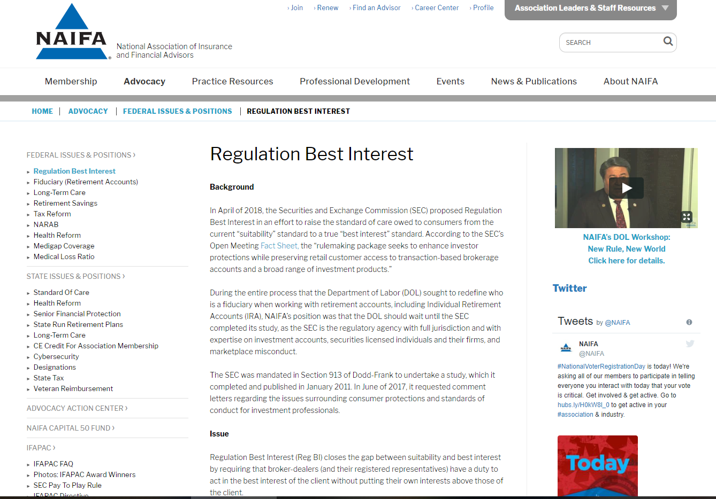
NAIFA Resources

Slide 27
Remember the Reg BI GOLDEN RULE
Follow Your Broker-Dealer’s Instructions and Procedures!!*
* And it is your responsibility to know and understand what these are!

